Slide 1


Flight delay Prediction

Slide 2

PROBLEM STATEMENT
Flight delays lead to inconvenience for passengers, financial losses for airlines, and operational challenges for airports.
This project addresses these limitations by employing advanced machine learning techniques to create a more reliable and precise flight delay prediction system.

Slide 3
Benefits of a Flight delay prediction system
Enhance Operational Efficiency
Improve Passenger Experience
Improved technological innovation for the betterment of the aviation industry.

Slide 4
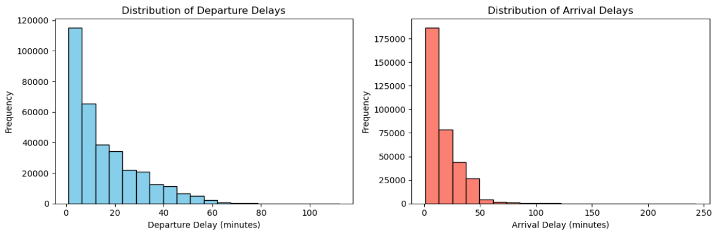
Exploratory Data Analysis (Univariate Analysis)
Analysis of Arrival and Departure Delays
Departure delay is right skewed with a minimum delay of 1 minute and a maximum delay of 112 mins. The mean delay is 19.86mins.
Arrival delay is right skewed with a minimum delay of 1 minute and a maximum delay of 243mins. The mean delay is 19.62 mins

Slide 5
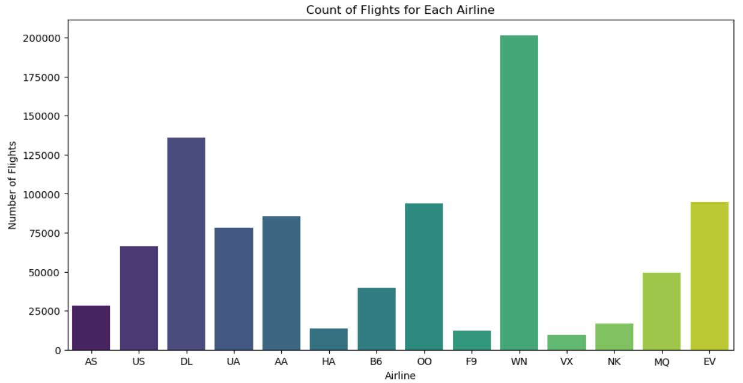
Exploratory Data Analysis (Univariate Analysis)
Analysis of flights per airline
Top 3 Airlines with the highest number of flights:
Southwest Airlines Co.(WN) - 201,529
Delta Air Lines Inc (DL) - 135,745
Atlantic Southeast Airlines (EV) - 94,749

Slide 6
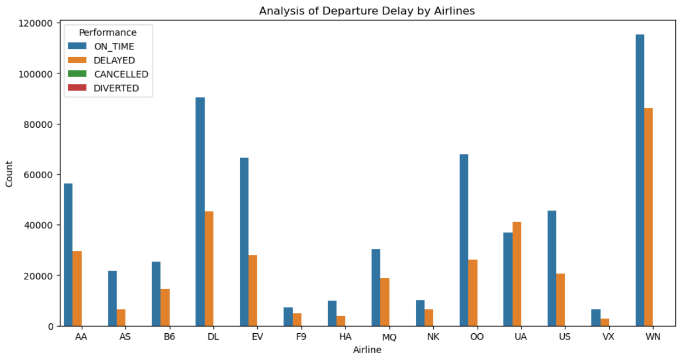
Exploratory Data Analysis (Bivariate Analysis)
Analysis of Departure Delay by Airlines
Top 3 Airlines with the lowest delay rates for Departure Flights
Hawaiian Airlines Inc.(HA) - 10.33 mins
Alaska Airlines Inc.(AS)- 13.98 mins
Delta Air Lines Inc.(DL)- 14.28 mins

Slide 7
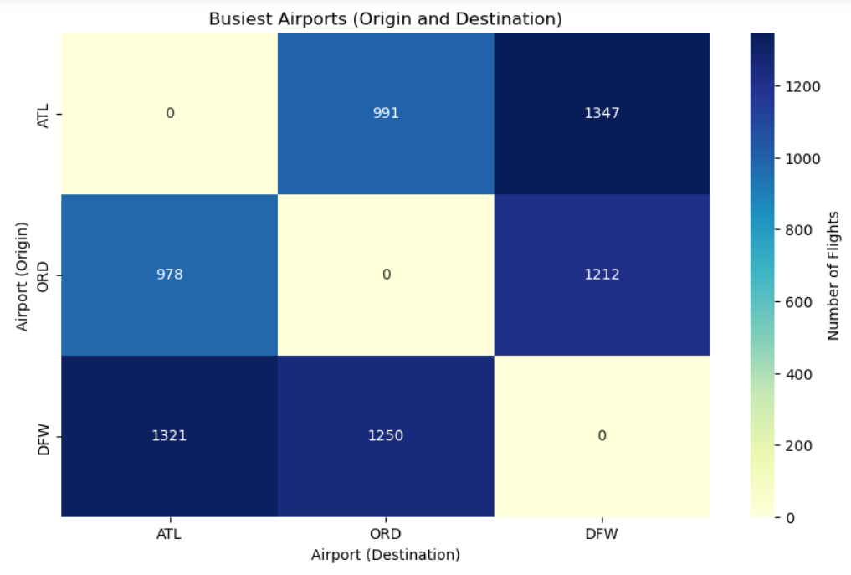
Multivariate Analysis (Correlation matrix)
Top 3 busiest airports(airports with the highest number of flights)
Hartsfield-Jackson Atlanta International Airport Atlanta Georgia - ATL
Dallas/Fort Worth International Airport Dallas-Fort Worth – DFW
Chicago O'Hare International Airport Chicago Ilinois - ORD

Slide 8

Data Preprocessing steps
Feature Engineering: The target label was separated, and the redundant variables were dropped.
Label Encoding: The arrival and departure delay columns were assigned a unique numerical label.
Scaling: The Standard scaler was used to scale the dataset.

Slide 9
Model Building and Evaluation
The data was split into 70% train and 30% test
The top 2 models based on Recall score are:
Naive Bayes(optimized) – 78%
Logistic Regression – 70%
Model determining metric: Recall Score
A model with a high recall score means it is good at identifying all instances of delay while minimizing false negatives, as high false negatives can hinder airport operational efficiencies.

Slide 10
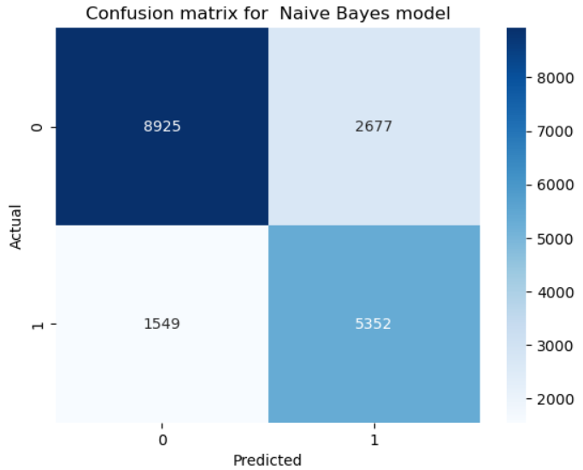
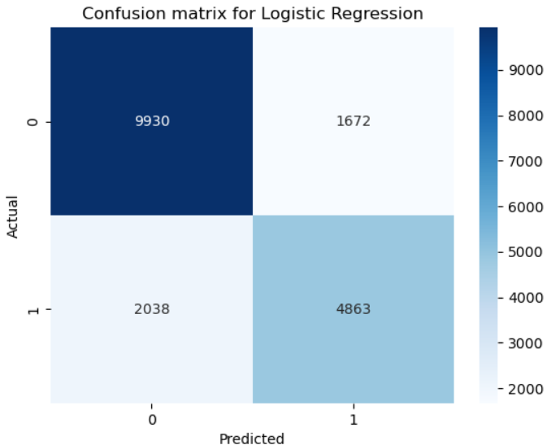
Model Evaluation (Confusion Matrix)
Naive Bayes
True Positives: 5352
False Negatives: 1549
Logistic Regression
True Positives: 4863
False Negatives: 2038

Slide 11

Conclusion
Considering the business objective, an ideal model should prioritize predicting low false negatives and high true positives. This is crucial as a high number of false negatives will hinder airport operational efficiencies.
Despite the Naïve Bayes model having a higher count of false positive predictions compared to logistic regression, the associated cost in this context is deemed lower than the potential cost of handling false negatives by the airport authorities. Consequently, the Naive Bayes model is selected as the optimal choice.

Slide 12

THANK YOU!

